Slide 1
IME Roundtable Virtual Meeting
September 14, 2023

Slide 2
Announcements
Zoom Meeting Reminders:
Mute when not speaking to limit background noise
Raise hand or use chat feature
Opt out of video if having connection issues
Meeting Minutes will be posted on L&I Webpage

Slide 3
9/14/23 IME Roundtable Meeting Agenda
Time | Topic | Presenters
9:30AM | Safety Message, Accountability Log Review | Troy Parks Melissa Dunbar
9:45AM | Program Updates: IME Telemedicine Rules Status / Originating Site Fee MEH updated July 1 – Review of Changes Worker Exit Survey Examiner Stats: Exit and Retention Surveys, Complaints YTD Examiner Pool Update Quality Reviews/AP Project/Page Count Analysis | Kristen Baldwin-Boe / Megan Lemon Troy Parks Tanya Weber/Dr. Azadeh Farohki
10:15AM | IME SI/SF Data Report: Purpose/How to Access/Data Comparisons Made | Nicole Mitchell
10:30AM | Break
10:40AM | SHB 1068 IME Recording Implementation: Status of implementation Rulemaking timeline Outstanding issues/questions Lessons Learned | Jen Lybbert Mindy Stokes Suzy Campbell
11:15AM | Claims and Scheduling Units Trends: SF disputes SI Protest Data Scheduling trends | Nancy Adams LaNae Lien Shannon Rushing
11:15AM-12:00PM | Q&A-Open discussion Round Robin IME Provider Topics | All

Slide 4
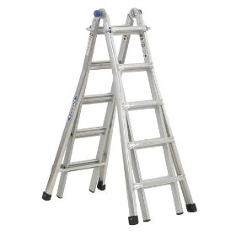
Safety Topic: Ladder Safety
Use the right ladder for the job
Inspect the ladder before use
  Make sure all parts of the ladder are working and there are no breaks in the rungs or sides
Set the ladder up correctly
  Make sure the feet are on a flat surface and will not slip
Climb and descend the ladder with caution
Maintain three points of contact
  Keep three points of contact when climbing up or down a ladder

Slide 5
Accountability: Issue Log
Issue: | Department Updates / Outcomes:
Interpreter scheduling issues | 1/12/23: Department will be soliciting Requests for Quotations and Qualifications (RFQQ) for interpreter services as existing contract expires in 2024. 5/4/23: RFQQ anticipated to be issued May. 9/14/23: RFQQ issued August; deadline for bids 9/25. Success rate for IME interpretations 88% (# completed/total requested less LEP no show and provider cancellations). IME unfulfillment rate average since December 2022 6%.
Fee Schedule Analysis/Clarification | 1/12/23: IME Fee schedule was analyzed and updated in 2022. Fee team to re-evaluate the new IME fee policy in 6 months – analyze results of July changes in February Testimony fees doubled effective 2023 Examining reducing administrative burden – firm site visits scheduled 4/3/23: Updates given at May meeting. 9/14/23: Fee increases went into effect 7/1/23. IME Telemed Originating Site Fee presentation and page count analysis presented @ RT.
High rate of IME reschedules, what is the root cause? | 1/12/23: Stuart has taken a new job assignment for a year. Scheduling data may be delayed until his replacement is hired. IME Steering Committee to evaluate this request 4/3/23: Update: Submitted to IME Steering Committee as new issue. 9/14/23: IME Scheduling unit provided data @ RT.

Slide 6
IME Program Updates
Kristen Baldwin-Boe
Troy Parks

Slide 7
IME Telemedicine WAC
IME Telemedicine Rule & How to Accommodate the Worker When No IME Specialty is Available Near the Worker
  Rules Adopted August 1, 2023
  Rules Effective September 1, 2023

Slide 8
Telemed Originating Site Fee – Q3014
Megan Lemon
Definitions:
Distant site: location of the provider who performs telehealth services. They’re not in the same location as the worker
Originating site: where the worker is located when receiving telehealth; they may be at home

Slide 9
Q3014 – Applicable to All Providers
Originating site fee is payable to the provider who allows a worker the use of their telecommunications equipment for a telehealth service with a provider at another location
No other service is provided at the originating site to the same patient concurrently
Don’t use Q3014 if the worker is at home, a service is provided to them during a telehealth visit with another provider, or audio only is used. The distant site provider can’t bill Q3014

Slide 10
Q3014 – IME Specifics
Q3014 is payable to the WA State IME firm when:
  The worker has an in-person exam that happens the same day as a telehealth exam, and
  The worker requires the use of the firm’s space for the visit with an approved IME provider for a telehealth exam, and
  The firm can’t use the space for another worker. No other service may be provided to the worker during the telehealth exam

Slide 11
Q3014 – What’s Not Covered
Q3014 isn’t covered when:
  The out of state provider is in a location not owned by the IME firm,
  The originating site provider performs any service for the same worker during a telehealth visit,
  The worker is at home,
  Billed by the distant site provider,
  The IME provider uses audio only

Slide 12
Q3014 – Example
A worker attends an in-person IME with a neurologist at an IME firm’s office in Yakima. The Yakima office bills for the exam. The Yakima site then arranges a space for the worker to participate in a mental heath IME with a psychiatrist at the firm’s Seattle location that same day.
The originating site (Yakima) may bill Q3014 with documentation of the use of their space for the bill, in addition to the exam from earlier in the day.
The distant site (Seattle) bills for the telehealth exam, but not Q3014. The Seattle office also used modifier –GT on their exam bill to indicate the exam took place via telehealth.

Slide 13
Medical Examiners’ Handbook Updates
Review July 2023 updates found inside the cover of the new MEH.
Added new RCW / Legislation
Updated WACs being repealed
Clarifications / Edits
Copied document into chat. Please review the latest updates and re-print the handbook if you use a printed version.

Slide 14
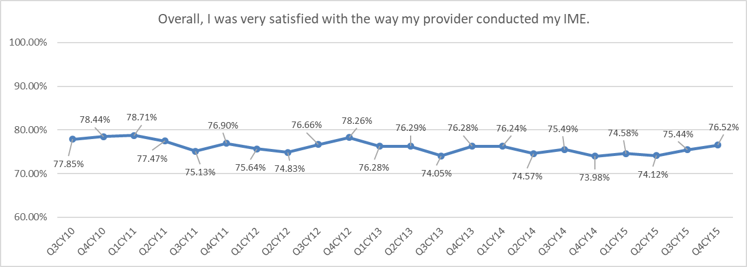
Worker IME Exit Survey: March 2010-2015
Direct mailings started July 2011 improving response rate
Overall worker satisfaction:
Median 76%
Two questions with highest correlation to overall satisfaction:
  Doctor took enough time to be thorough and complete?
  Examiner familiar with medical hx
Mailings were cumbersome results hard to collate
Lack of useful trend data
Response rate in CY 2011 was 10.57%

Slide 15

Exit Survey Revamp 2023
Opportunity to automate process using agency approved online survey tool Alchemer
Review prior questions; opportunity to ask more objective and pointed questions to measure quality?
Ensure feedback loop to inform IME policy, operations, address service gaps and help facilitate firm engagement
Best practices, recommendations?

Slide 16
New Survey Objectives?
No leading questions
Solicit objective vs. subjective responses
Higher response rate
Gain insight into operational and quality aspects of exams

Slide 17

Survey Feedback and Next Steps…
Impressions/suggestions to improve questions?
Additional stakeholder engagement through August 2023
Develop, design, test Alchemer online survey
Claims IME scheduling document integration
Go live January 1, 2024

Slide 18
IME Examiner Retention Survey (YTD-Sept 2023):
5 responses (Scale 1-10; Average 7)
Ways to improve Score?
Better adjudication of worker conditions
Accept examiner MMI determinations
Higher reimbursement for large files, market equity with other states
More efficiencies: better assignment letters, quicker access to files
Ways L&I could improve IME process?
Purge unnecessary and duplicate records i.e. >5 yrs old, etc.
COVID impact to workers accessing care/Claims Mgrs working from home inaccessible
Self insured requests should contain all accepted conditions and relevant records

Slide 19
IME Examiner Exit Survey (YTD-Sept 23)
2 responses
72% responses to 9 questions on Likert scale were affirmative
Reason for disagreeing: contractual concerns w/ firm, collating of records, travel accommodations
Reason for leaving: both due to having to maintain board certification
No difference between SF/SI

Slide 20
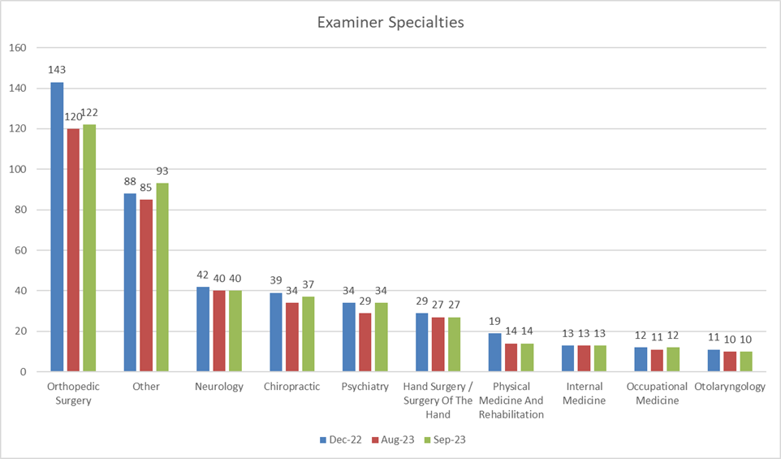
Examiner Pool Trend-Top Specialties

Slide 21
Examiner Pool Stats
December 2022:
344 unique examiners
September 2023:
312 unique examiners

Slide 22
2023 IME Complaints-YTD through 9/1
89 Complaints
Top Specialties:
  Orthopedic Surgeon
  Neurology

Slide 23
  IME Quality Review Trends
  Tanya Weber, BSN RN
  IME Occupational Nurse Consultant

Slide 24
IME Quality Review Type by Year*
*excludes telehealth IME reviews
Notes:
Here is a snapshot of the volume and type of reviews I have completed since 2020. Review of re-certifying examiners has been and will continue to be the bulk of my work. Next slide please!

Slide 25
Top 10 Specialties of IMEs reviewed*
Notes:
Here’s another snaphot that shows orthopedists continue to remain the highest number of reviews I have completed followed by neurology. This demonstrates the type of injuries & conditions we are dealing with the most. Let’s take a look at Ortho IME data. Next slide please!

Slide 26
Ortho vs All Other Specialties
Notes:
We have collected data since 2020 that tracks non-billable addendum requests for all of the specialties. The standard for nb addendums ideally should be no greater than 1%. This data shows that orthopedists have continued to trend a few percentage points higher than other specialties who are meeting the standard, and continues to suggest that orthopedists need additional resources in order to bring down their rate . Dr. Farokhi and I are meeting to look at adding to the MEH as a reference for examiners. Dr. Farohki, would you like to speak to this a bit?

Slide 27
Telehealth vs Non-Telehealth
Notes:
Now let’s look at telehealth. I have completed 415 telehealth IME report reviews since March of 2020. One of the data points I capture in the review process is whether the examiner opined on an injury or condition that was not requested by the Department. It’s also a data point that has been captured for all other IMEs, so I decided to do a comparison. The standard for this should be <1% and when it happens, it muddies not only the IME, but also the claim. And so when we look at % of telehealth IMEs that have this occurring, it begs the question of whether this is related to telehealth itself or an issue of the specialty using telehealth, which is psychiatry. Let’s take a look at that comparison.

Slide 28
Telehealth Psych vs Non-Telehealth Psych
Notes:
As you can see, non-telehealth psych had <1% through this period. My plan is to go back and make sure my data elements are correct and if so, do a deeper dive on this one to determine why this is occurring for telehealth psych IMEs. If there is something I can share, there will be more to come!

Slide 29
Your Input is Valuable & Vital
IME trends – are there specific areas you’d like to know more about?
Please email ideas to Tanya.Weber@lni.wa.gov.

Slide 30

Questions?

Slide 31
Project Updates

Slide 32
Upcoming Projects
Improve availability and quality of AP documentation
  Preliminary Stakeholders
    HSA: Kristen Baldwin-Boe, Tanya Weber, Terri Baughman
    Legal: Jacqueline Ford and Elizabeth Holloman
    Claims: Nancy Adams
    Self-Insurance: LaNae Lien
    OMD: Azadeh Farokhi, ONC supervisor
Best practices for IME documentation
  Potentially include with IME page count project & IME Quality Improvement project

Slide 33
IME Page Count Project Update

Slide 34
Page Count Request
Dr. Toomey reached out requesting reviewing a reasonable threshold for page count
  Asked to keep track of IMEs performed, and provide number of pages in record reviewed and time
    Everett clinic, Wenatchee clinic, and Seattle clinic

Slide 35
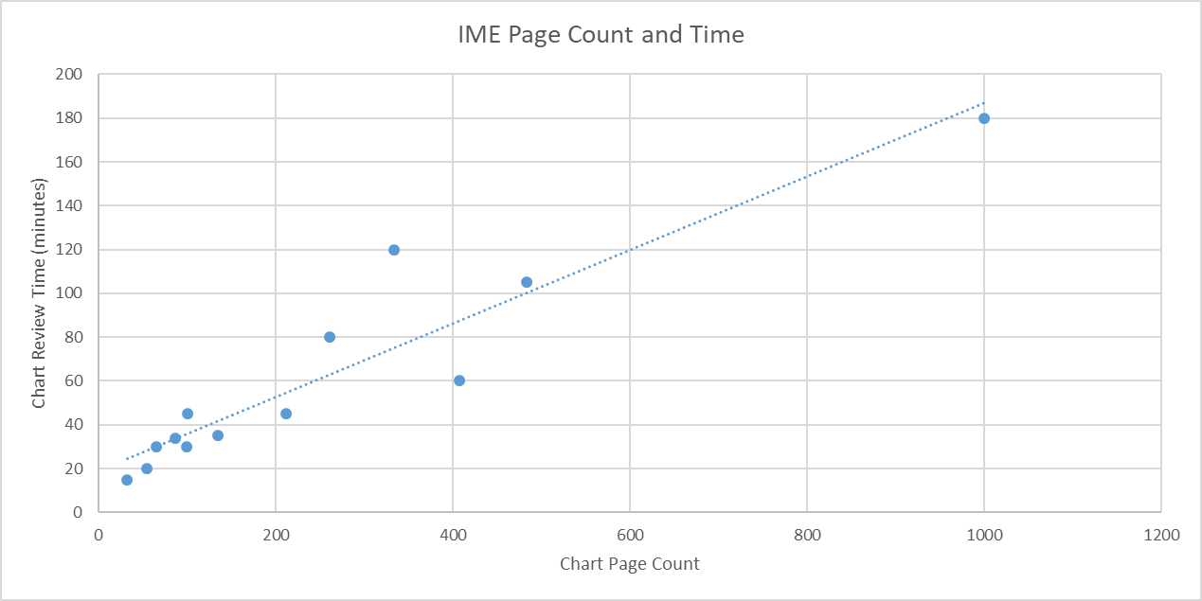
IME Examiner Data: Page Count & Review Time
Notes:
Dr. Toomey kept track of cases over 3 different clinics and provided me with number of pages reviewed and time it took him to review.

Slide 36
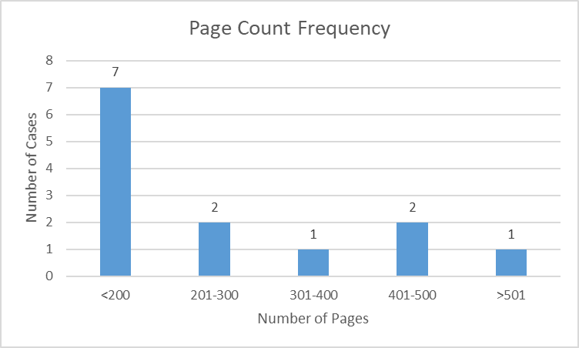
IME Examiner Data: Page Count Frequency

Slide 37
Current 1129M Data
Data 1129M bills paid 7/1/22-7/31/23:
  5,458 instances of billing:
    Average Page Count- 798
    Median Page Count- 662
    Min Page- 401/Max Page- 4,882
  3,020 unique claim IDs associated with 1129M
    Approx. 22% of all IMEs from 2022
  Total Paid 1129M= $2,323,711

Slide 38
Next Steps..
Self-Insured – what records are reviewed
Consider working with IME firms and examiners
  How many pages of records are reviewed vs. sent
  Track more examiners on page count reviewed and time
Wider lens
  IME best practices and quality

Slide 39
Questions?

Slide 40
IME SI/SF Data Report
Nicole Mitchell
August 10, 2023

Slide 41
How to Access the New IME Report
Go to lni.wa.gov/
Scroll to the bottom
Select “About L&I”
Select the “Public Data” tab
Open the report titled “Independent Medical Examination (IME) Report”

Slide 42
Purpose of the Report
Make data available to interested parties
Monitor emerging trends
Aid discussions about IMEs
Make use of a new data source: Self-Insurance Medical Bills (employer reported)
Differentiate data from the State Fund and Self-Insurance

Slide 43
Data Comparisons Made
Number of IMEs per claim
Percent of claims with IMEs
Days to first IME
Days between IMEs
Number of IMEs by date of service
Top purposes for IMEs (State Fund only)

Slide 44
Questions?
IMEReporting@Lni.wa.gov

Slide 45

10 Minute Break…

Slide 46
SHB 1068:
IME Recording Bill Implementation Update

Slide 47

SHB 1068-IME Recording Bill Implementation
Activities completed through August…
  Finalized process workflows for interim technology solution
  Drafted FAQ v2
  Planning of Fraud Program Process for investigations on altered recordings
  Finalized “Facts about IME Recordings”
  Test interim tech solution with super users (Tier 2 support)
  Created interim solution implementation timeline

Slide 48
September Implementation Activities…
Spanish translation for “Facts about IME Recordings” publication and distribution with webpage updates and Gov Delivery email
Customer Acceptance Testing for interim technology solution
Training staff on interim technology solution
Stakeholder engagement: IME Roundtable and IME Educational Seminar for 1068 Project Updates
Change management activities: Internal staff “pulse check” surveys and communications
Begin research plan for permanent technology solution

Slide 49

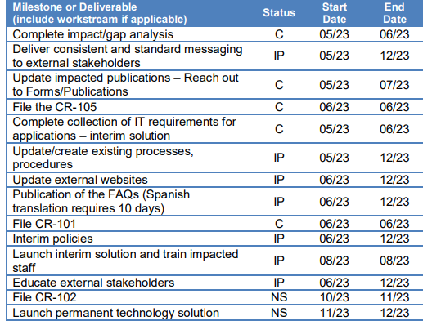
Key Milestones…
Key: ‘C’ = Complete; ‘NS’ – Not Started; ‘IP’ = In Progress

Slide 50
Questions?

Slide 51
Claims Department Updates – Nancy Adams
IME Protest Data
SHB 1068 update-Impact to Claims

Slide 52
Questions?

Slide 53
Self-Insurance IME Dispute Data
August 2022 - present

Slide 54
Data updated through 07/20/23

Slide 55
Data updated through 07/20/23

Slide 56
Data updated through 07/20/23

Slide 57
Questions?

Slide 58
IME Scheduling Trends
Shannon Estrada

Slide 59
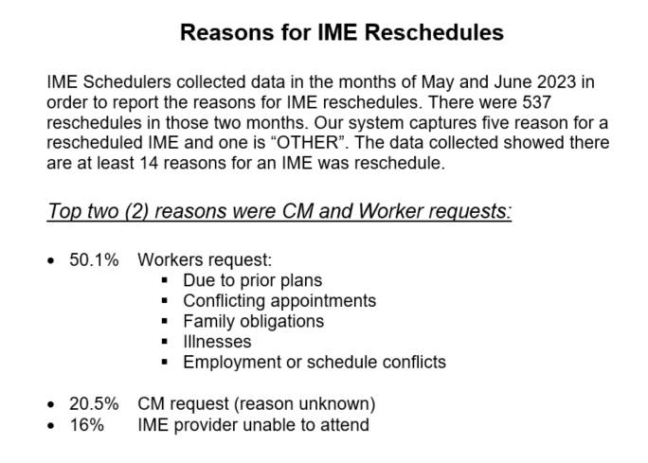

Slide 60
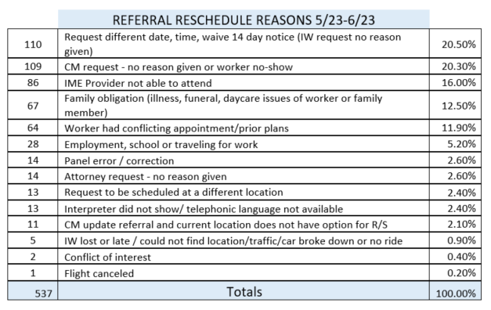

Slide 61
Questions?

Slide 62
Outstanding Issues/Questions
Has IME scheduling placed an administrative burden on you and your staff?
  Are there things L&I can do to ease that burden?
When a worker notifies you that they plan to record the exam, do you notify them in return to let them know that you plan to record too?
  If you do, how do you notify them? Has this provided a solution to this issue?
Let’s brainstorm solutions to this problem of co-recording.

Slide 63
Open Discussion – IME Providers
IME Provider Topics
Questions & Comments
Future Topic Suggestions
Next Meetings:
  January 11, 2024
  May 9, 2024

