Slide 1
IME Roundtable Meeting
September 17, 2026

Slide 2
Announcements
Online Meeting Reminders:
Mute when not speaking to limit background noise
Raise hand or use chat feature
Opt out of video if having connection issues
Meeting Minutes will be posted on L&I Webpage

Slide 3
Time | Topic | Presenters
9:30AM | Announcements, Safety Message, Agenda | Troy Parks, Melissa Dunbar
9:40AM | Program Updates: Examiner Pool Complaints Late Reports Psych IME Criteria | Troy Parks Joann Willyerd Cicely Hartwick
10:00AM | IME Recording: Third-Party Recording Update Utilization Data | Troy Parks
10:10AM | IME Complaint Process: Future State | Troy Parks
10:30AM | L&I Unit Updates: Claims Scheduling Scheduling on holidays Self-Insurance | Nancy Adams Trisha Lamb LaNae Lien
10:45AM | Break
10:55AM | Fee Schedule: Fee Analysis/Trends Priorities and work plan development | Megan Lemon Troy Parks
12:00PM-12:30PM | Q&A-Open discussion Round Robin Q&A Future Topic Suggestions | All

Slide 4

Safety Topic: Ladder Safety
Use the right ladder for the job
Inspect the ladder before use
  Make sure all parts of the ladder are working and there are no breaks in the rungs or sides
Set the ladder up correctly
  Make sure the feet are on a flat surface and will not slip
Climb and descend the ladder with caution
Maintain three points of contact
  Keep three points of contact when climbing up or down a ladder

Slide 5
Accountability: Issue Log
Issue: | Department Updates / Outcomes:
Interpreter scheduling issues | 6/11/26: New contract solicitation update. 1/15/26: End user survey responses and solicitation; update on utilization. 9/18/25: Utilization data update. 5/22/25: Utilization data presented; discussion on mitigation efforts to ensure weekend coverage for IME firms. 1/16/25: Update on IME utilization and roll out of on-demand over the phone 1/2/25. 6/17/24: Go Live!
Legislative Bill that allowed recording of IMEs | 6/11/26: Share utilization data and impact of service; reminder of how workers can view recordings. 1/15/26: Review utilization data and show impact of pilot. 9/18/25: Pilot feedback and extension. 5/22/25: Recording pilot update. Co-recording rule writing abandoned/code reviser filing repealed. 1/7/25: GovDelivery message on delay in co-recording rule writing. Upcoming 3rd party recording pilot March-August 2025.
Billing Issues/Policy | 6/11/26: Itemization and prioritization of billing topics/fees and development of work plan to conduct analysis of priorities. 1/15/26: Update on 2 billing issues-1) 1129M (>50 page count)/1104M (addendum) billing combination; 2) Billing multiple units CPT radiology interpretation codes (70000 series). 9/18/25: Clinical IME Roundtable session topic for 2026 to ensure objective questions are being asked of examiners and to refine scope of future requests. 5/22/25: firms shared concerns with large addendum requests associated with state fund claims and fraud investigations. Current reimbursement rate of $168.19 is a global fee (file review included). Department is exploring payment options to address the extra amount of time it takes for examiners to review new records. One option is quantifying # of pages included in the fee reimbursement and allowing billing of 1129M (Extensive File Review) for pages after set threshold. L&I met with CSP on fraud investigator requests and explored ways to improve processes. Additional engagement expected to scope questions being asked of examiners and to refine scope of future requests.

Slide 6
IME Program Updates

Slide 7
IME Examiner Pool
Top examiner Specialties
Trend all examiners

Slide 8
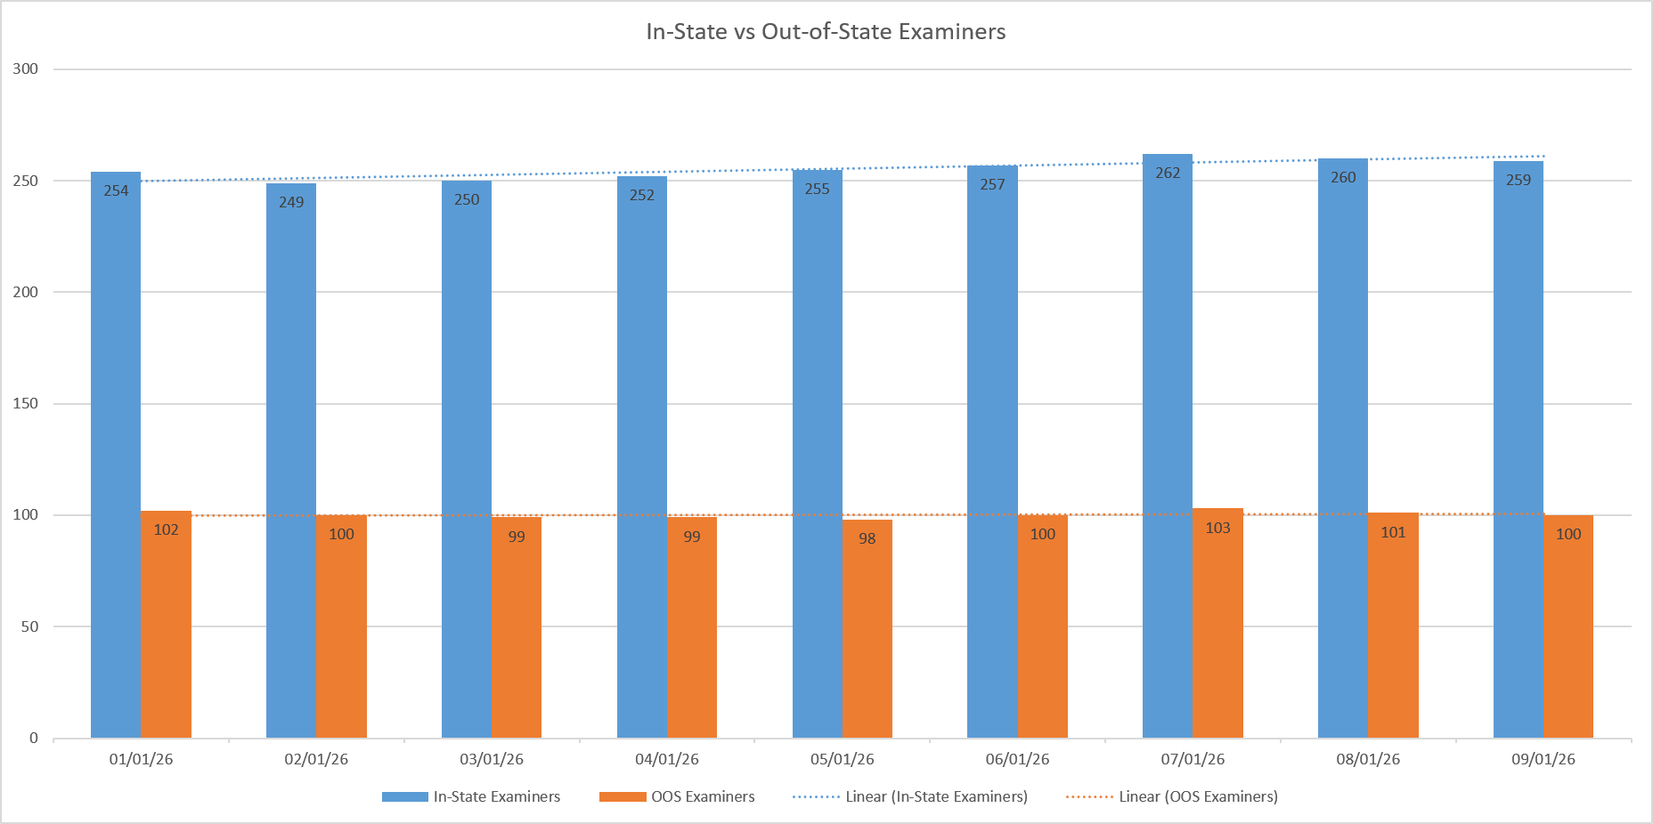

Slide 9
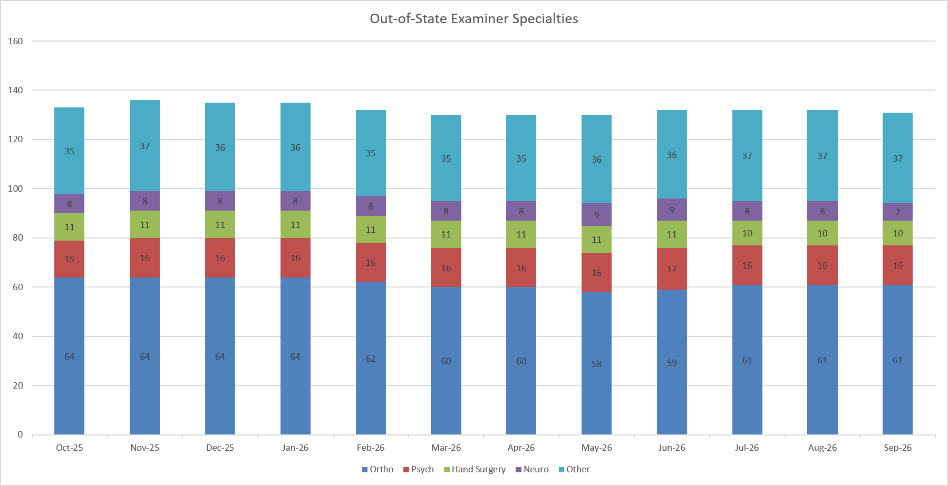

Slide 10
2026 Complaints-YTD
389 Complaints (as of 9/14)
Top Specialties:
  Ortho (136)
  Psychiatry (70)
  Neurology (53)
  Hand Surgeon (49)
360(92.5%) involving state fund claims
229 (76%) of “report” complaints=late reports
Note: 2025 Approx. 15,408 exams; 397 complaints received (2.57% of all exams)

Slide 11
Late Reports: Complaint Process Update
Weekly emails are sent to IME Firms with reports past due
(14 days after the IME date)
  This has been effective in reducing the number of late reports:
      Average total late reports were 12-15 per week
      Average total late reports are now 7-9 per week

Slide 12
Root Causes of Late Reports
  Diagnostics – Communicate orders with the claims manager
    In order for department to determine if report is truly late, please ensure scheduling system is updated with following annotations about diagnostics:
        Ordered
        Scheduled
        Results are received
  Examiner Leave
      Do not schedule within 14-day window
      Have contingency in place to ensure timely delivery

Slide 14
Highlights of Required Documentation for Mental Health IMEs
Medical Examiner’s Handbook, Chapter 7
1. Identifying Information
2. Introduction, Purpose of Examination and Statement of Non-Confidentiality
3. Record Review: mental health and medical records
  Report of Accident or Provider’s Initial Report
  Timing of mental health complaints
  Past medical and mental history

Slide 15
4. History from the Worker
  History of the present injury
  Mental health complaints: current symptoms with specific examples and how examples affect functioning, change in symptoms over time, current and history of treatment and response to treatment
  Pre-injury and Post-injury functioning
  Other stressors
  Worker’s Compensation/work history
5. Mental Health Examination and Testing
  Orientation/Attention, speech, impulse control, delusion/hallucination, insight, judgement
  Assessment measures: interpret previous mental health test results from treating providers
6. Diagnosis(es) and Findings
  This report must contain data that support your diagnoses and conclusions.
  Use of DSM-5 criteria is required. Describe specific details related to this worker for each criterion.

Slide 16
7. Discussion, Including Assessment of Work-Relatedness and Pre-Existing Conditions
8. MMI or Treatment Recommendations
  If the worker has reached MMI, please explain
  If not at MMI, do you recommend treatment or additional treatment? Reference MEH pg. 62 for list of questions to address if treatment is recommended.
9. Impairment Rating
  If asked to provide and impairment rating, first determine if the worker is at MMI with respect to the mental health condition accepted on the claim.
  If the worker is at MMI, provide all essential elements: MMI, examination findings (examiner observations of behavior and function, as well as symptoms reported by the worker), diagnostic studies (if any), rating per WAC 296-20-340 and rationale.
  Effects of pre-existing mental health conditions (WAC 296-20-330)
10. Answers to Specific Questions from the Claim Manager

Slide 18

IME Recording Update

Slide 20
IME Recording Utilization (March 2025-July 2026)
11% IME referrals involve request to record
14.4% cancellation rate for recording requests (compared to 54.8% cancel rate August 2023)
  86% completion rate
  76.4% of recording request cancels involve represented workers
899 third-party recordings (2 per day/53 monthly average)
  27% of all recordings use third-party service

Slide 21
Third-Party Recording Reminders…
Provide worker a copy of recording memo at exam that describes how they can obtain access to their recording.
Requests for access to recording by worker can be made by emailing: IMERecordings@lni.wa.gov

Slide 23
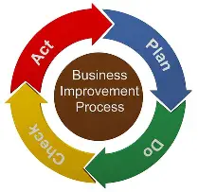
IME Complaint Process Project
Background
  Why are we embarking on this effort?
  What are we hoping to achieve
Scope
  Assess current processes
  Identify “pain points” and process improvement opportunities
  External partner feedback
Outcomes
  Workflow mapping of future state
  Enhanced transparency and outcome measurement

Slide 24
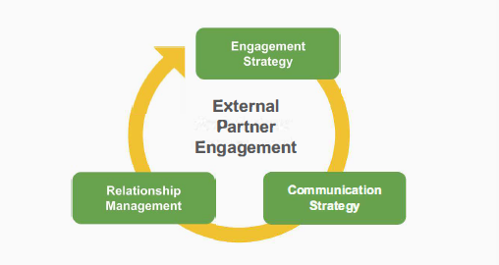
Goals of listening session…
Convey existing processes
Feedback on identified or undocumented “pain points” and process improvement opportunities
Identify future communication strategy

Slide 25
Process Improvements Implemented….
Four recommendations from listening session:
  Modify written acknowledgement to complainant, asking if they would like department staff to reach out to obtain more details
  Notification at 60 days if investigation is still ongoing
  Verbal notification to complainant prior to issuing written closure/outcome response
  Summary of complaints to examiner at time of renewal

Slide 26
IME Complaint Reporting to Examiners
IME complaint synopsis shared with examiners at renewal cycle:
    Date of IME
    Summary of Allegation
    Date of Complaint
    Disposition of Complaint
Complaints since last renewal

Slide 28
Claims Department – Nancy Adams
Questions?

Slide 29
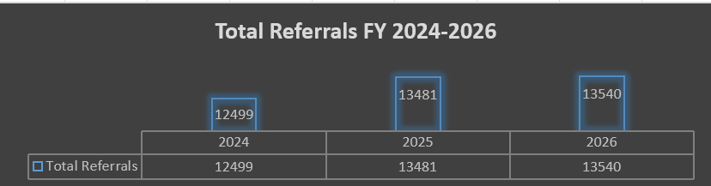
IME Scheduling Trends – Trisha Lamb
Referral Data
Scheduling on holidays

Slide 30
Self-Insurance – LaNae Lien
Self-Insurance Questions?

Slide 32

10 Minute Break…

Slide 33
Fee Analysis Trends – Megan Lemon
Review referral trends
Review total paid trends

Slide 34
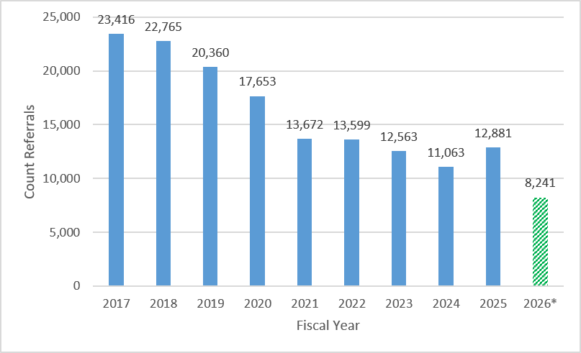
Referrals Since 2017
*Note: billing data is incomplete for FY2026 (July 1, 2025 - June 30, 2026). We expect these numbers to adjust upward as we finalize billing.

Slide 35
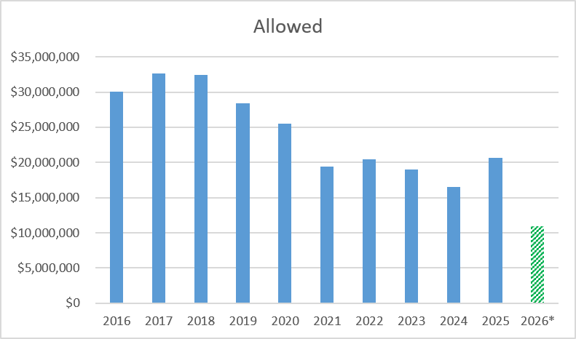
Total Allowed per Year
*Note: billing data is incomplete for FY2026 (July 1, 2025 - June 30, 2026). We expect these numbers to adjust upward as we finalize billing.
Notes:
Strictly the total allowed paid across all IMEs from our data.

Slide 36
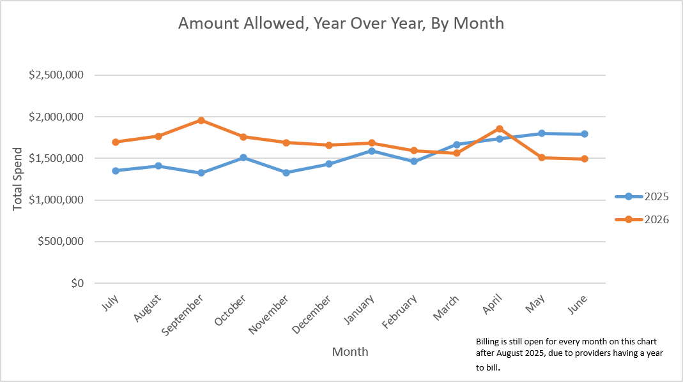
Comparison Year over Year, by Month
*Note: billing data is incomplete for FY2026 (July 1, 2025-June 30, 2026) due to having one year from date of service to bill. We expect these numbers will adjust as we finalize billing.

Slide 37
In Conclusion
Continuing to monitor total IME spend and referrals
All providers (including IME) received a 3.74% COLA in 2026

Slide 38
IME Fee Schedule
July 1, 2026 COLA of 3.74%
September 17th Roundtable Presentation on Reimbursement Trends
Identify and prioritize areas warranting further analysis
Develop work plan

Slide 39
Fee Schedule: Prioritization of Issues
Issue | Description/Concern
Page count threshold for bundled exam fee | <400 pages cap for bundled exam; community standard is 150 pages per hour; reimbursement incommensurate with what L&I consultants are being paid (hourly). Firms still ask why 1132M (document handling, per page) and 1133M (CAC document processing) fees were discontinued in 2022. These costs were bundled into the exam fee and 1129M was created for pages in excess of 400.
Record review compensation associated with no shows, and late cancellations | 1129M extensive file review is not allowed to be billed when an exam is cancelled or worker is a no-show. Examiners would like to be compensated for their review of medical records done in preparation for the exam.
Diagnostics: compensation for review of additional records/reports associated with ordered diagnostics | Currently, examiners order diagnostics and complete exam upon receipt and interpretation of testing. This leads to delay in department or employer from receiving reports and examiners have expressed concern that having to interpret diagnostics can lead to extensive review of additional records medical decision making warranting the billing for an addendum.
Duplicate medical records submitted to firms | Examiners and firms have expressed frustration with records received for exams which contain duplicates, are not collated in logical manner, and are not presented chronologically.

Slide 40
Brainstorm #1: Impact of Issue
What is impact of page count threshold to you?
  Time
  Burden
  Cost
  Direct/indirect
5 Minutes: type your responses in Chat; to not push “send” until end to prevent group think/bias

Slide 41
Brainstorm #2: Analysis Needed
How would you go about analyzing page count issue?
  Data needed
  Process/steps
5 Minutes: type your responses in Chat; to not push “send” until end to prevent group think/bias

Slide 42
Brainstorm #3: Expectations/Success
What would you need to see to ensure you are comfortable with the completed analysis of page count issue?
  Outputs (communication, documentation, engagement)
5 Minutes: type your responses in Chat; to not push “send” until end to prevent group think/bias

Slide 43
Prioritization of Analysis Action Steps
Use impact and expectations to inform
  Use criteria from brainstorm 1 (impacts) & 3 (expectations) to prioritize
Itemization of analysis steps by priority
  Work plan and resource identification
  Next steps

Slide 45
Open Discussion – IME Providers
Questions & Comments
Future Topic Suggestions
Next Meeting:
  January 14, 2027

